Slide 1
QUESTION # 4 (Side By Side)
Syed Measum (201101001)
Sir Sajid Majeed

Slide 2
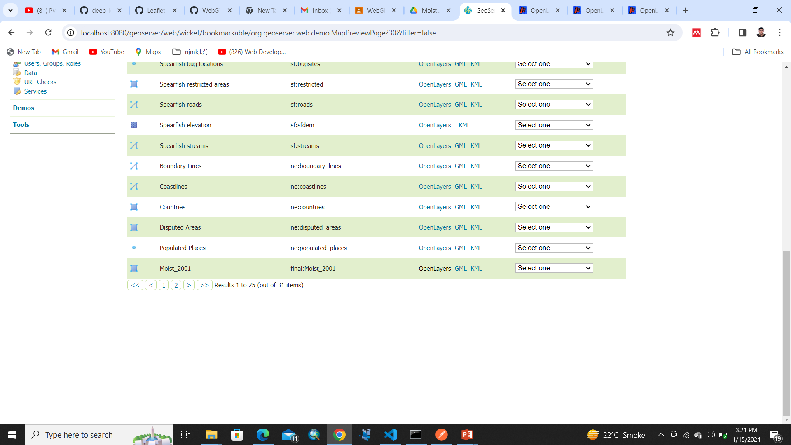
Moisture 2001

Slide 3

Moisture 2001 Layer preview Blank

Slide 4
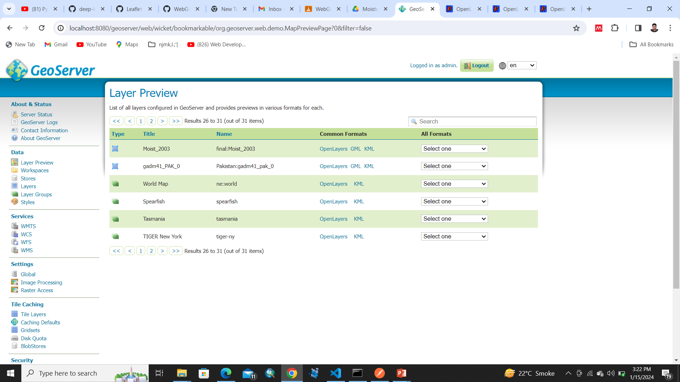
Moisture 2003

Slide 5
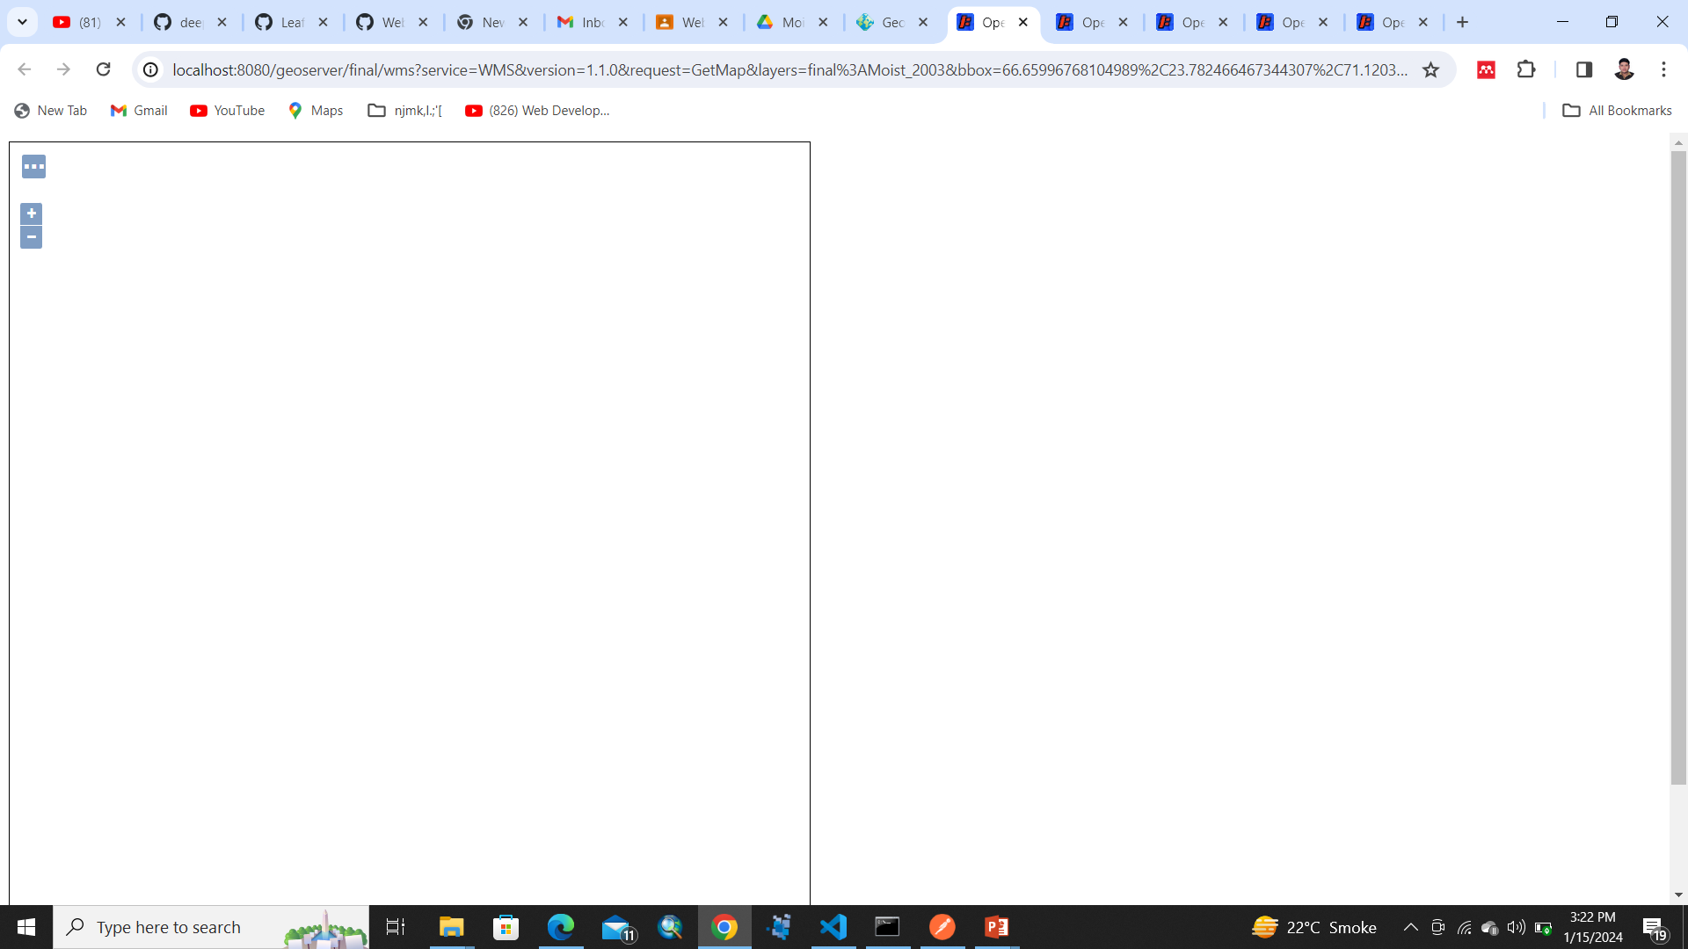
Moisture 2003 Layer preview Blank

Slide 6
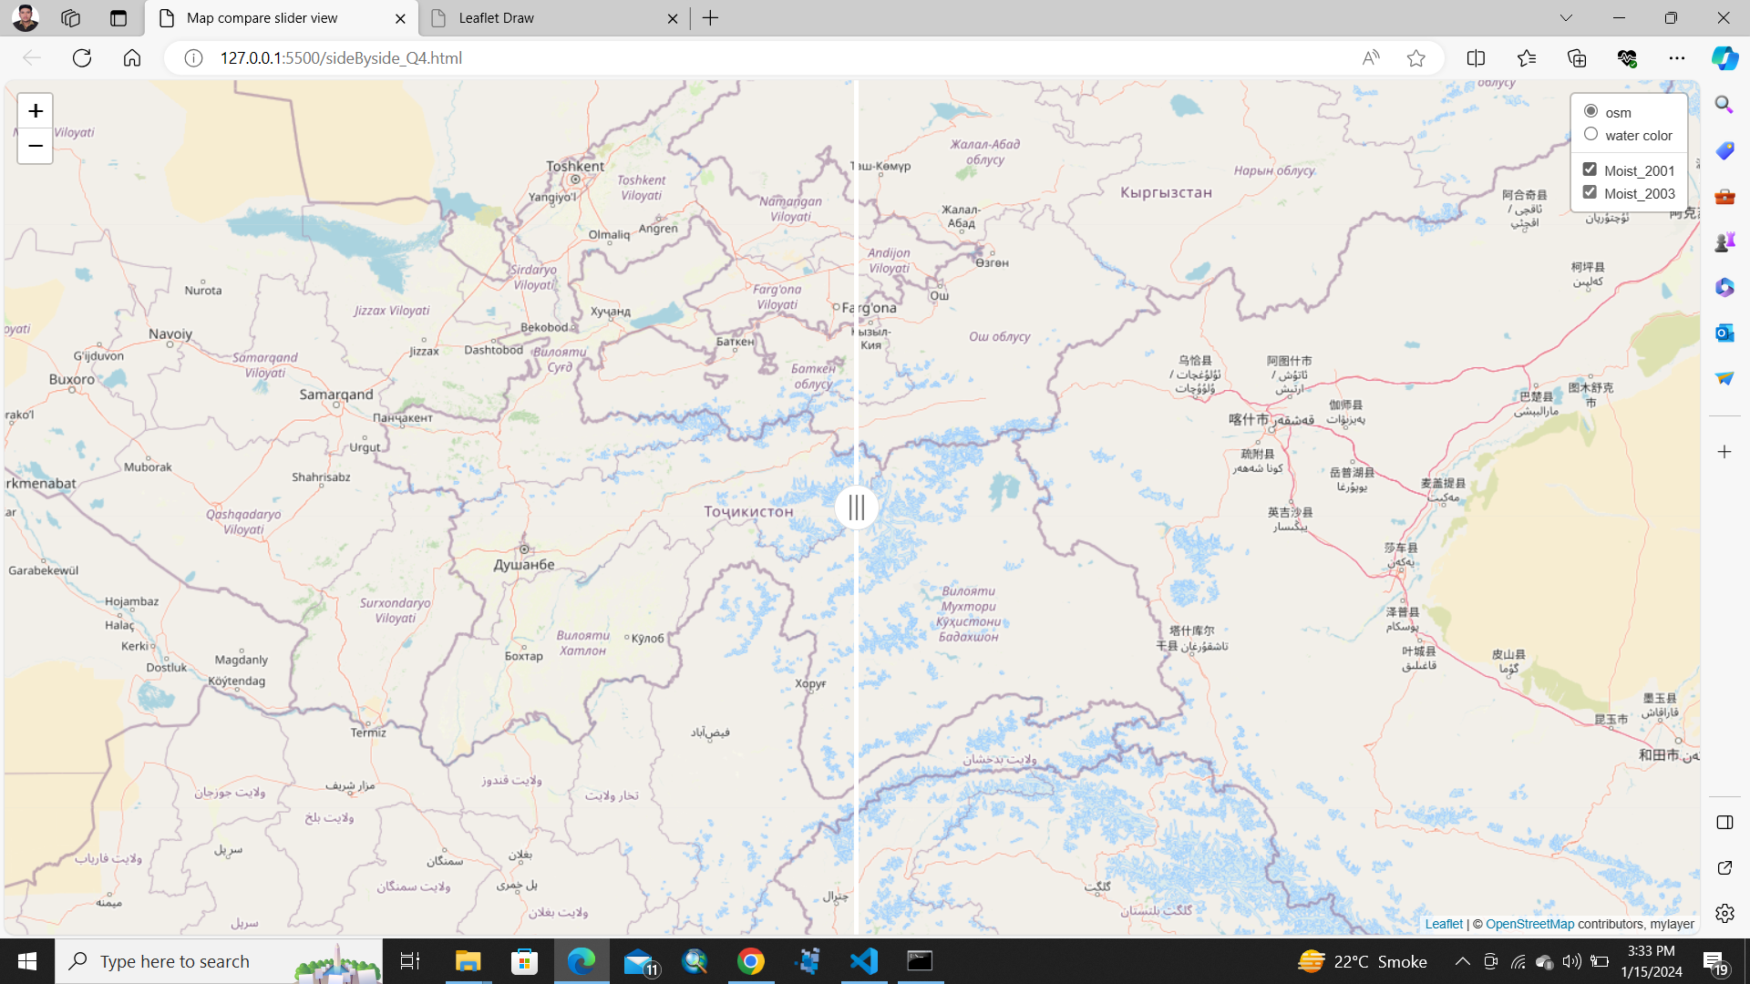
Html view

